Slide 1
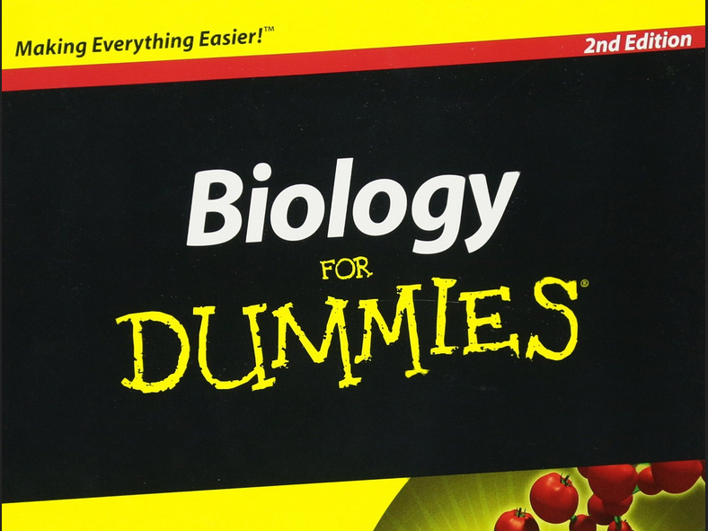
Bioinformaticians
Gregor Gilfillan

Slide 2
Topics:
Tree of life
Building blocks of life
Structure (and differences) of DNA and RNA
DNA makes RNA makes protein
Genomes and genomic features
Genetics
Epigenetics

Slide 3
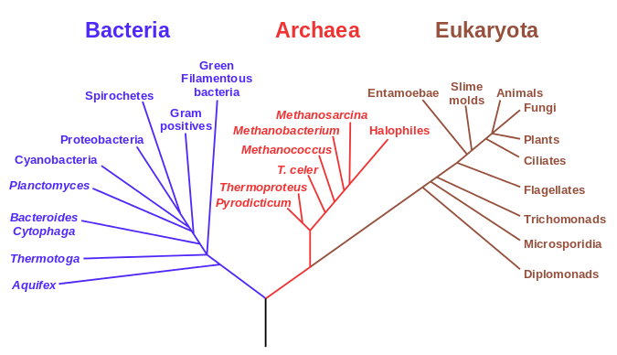
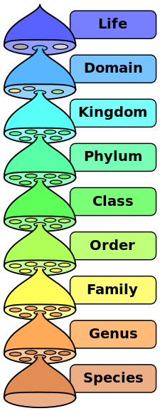
1. Phylogenetic tree of life
Hierarchical classification of life
Prokaryotes
Eukaryotes
Tree assembled by comparison of rDNA sequences.
Viruses?
wikipedia

Slide 4
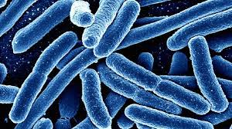
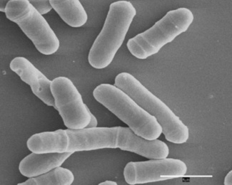
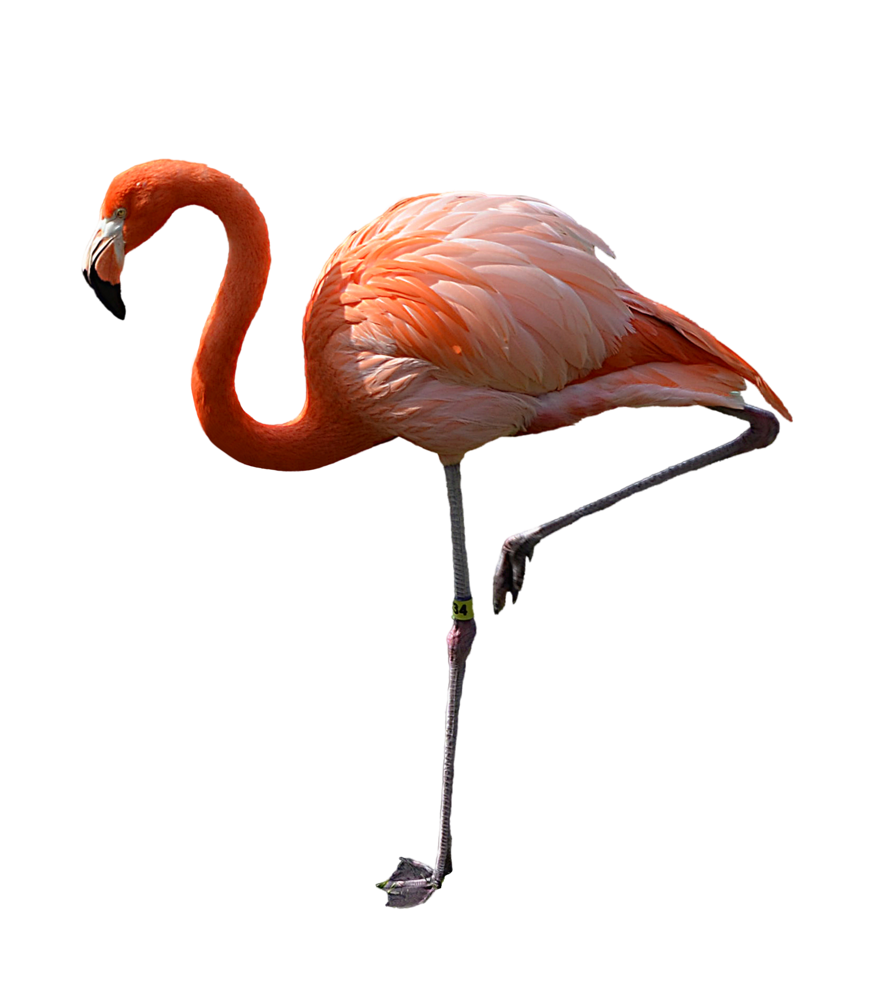
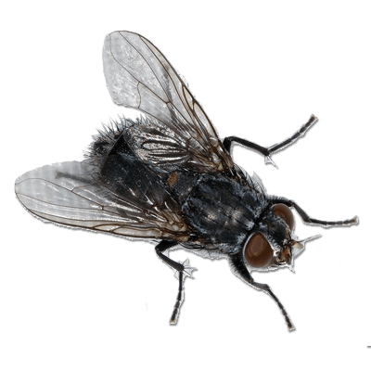
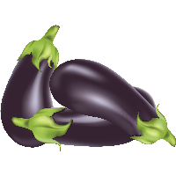
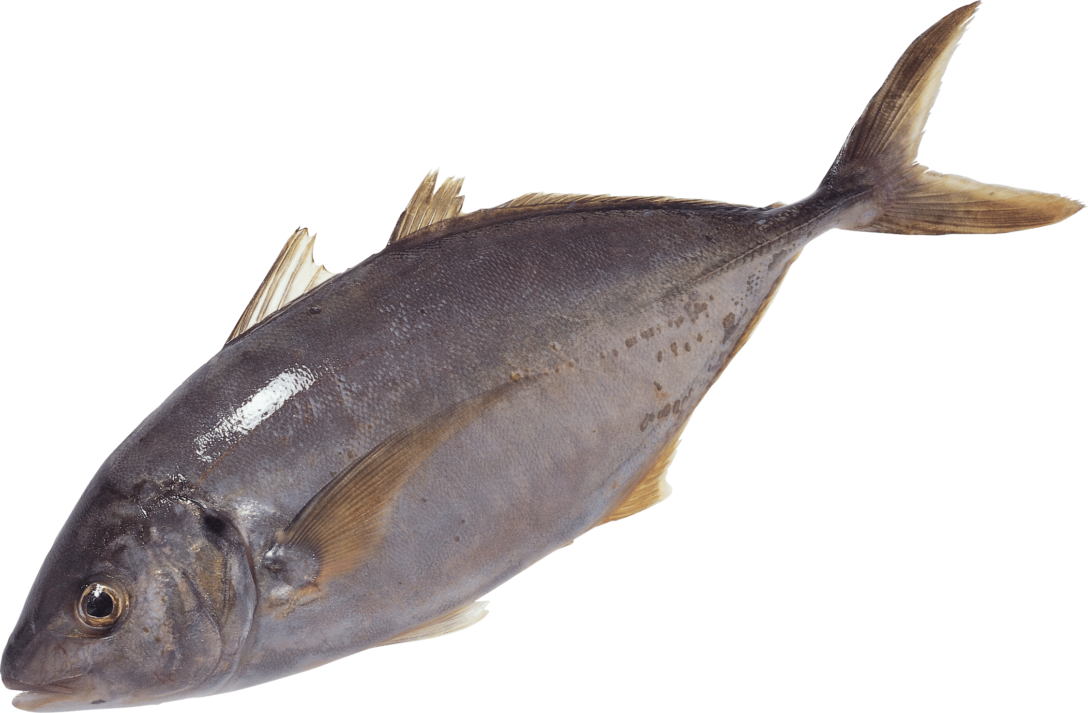
Prokaryotes vs Eukaryotes
Prokaryote
Size
Ribosome type
Chromosomes
Histone proteins
Membranes with steroid content
Eukaryote
Defining differences = Eukaryotes:
- Contain DNA in a nucleus
- Contain organelles
(mitochondria, also chloroplasts in some)

Slide 5
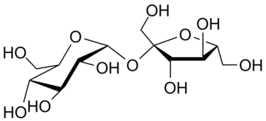
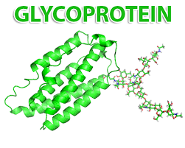
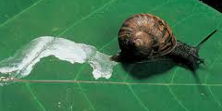
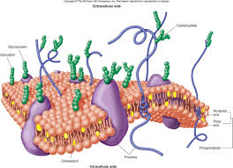
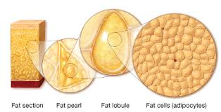
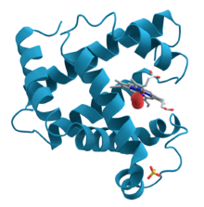
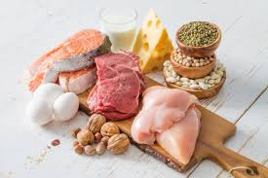
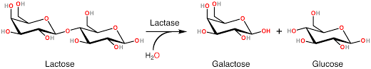
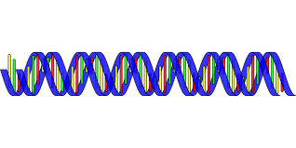
2. Building blocks of life
Carbohydrates
Energy / Structure / Identification / Lubrication / co-metabolites
Lipids (fats)
Energy storage / membranes / signaling / insulation
Proteins
Structures / Enzymes / signaling
Information storage and transfer / ribozymes
Nucleic acids

Slide 6
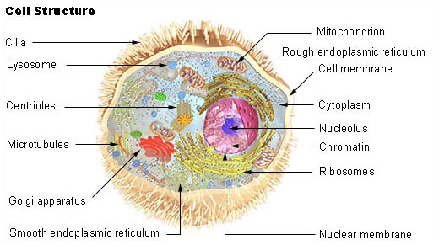
Basic unit of life: the cell
Mitochondrial genome
(10-10,000 copies/cell)
wikipedia
Average human = 10¹⁴ cells
Typical eukaryotic cell ca. 25 µm diameter / Typical bacterium ca. 1 µm
Smallest known cell (mycobacteria) = 0.1 µm
Largest (ostrich egg) = 20 cm

Slide 7
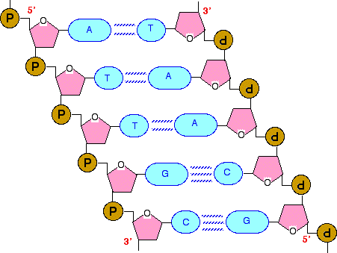
3. Structure and features of DNA and RNA
chemguide.co.uk

Slide 8
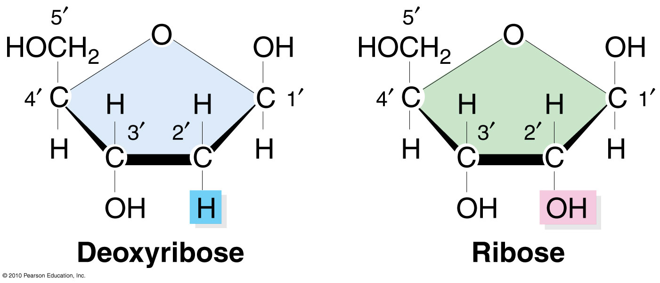
Sugar-phosphate backbone, bases and nucleotides
Ribose (found in RNA)
Deoxyribose (found in DNA)
- Planar sugar molecules
- Carbon atoms 1-5 (numbered clockwise, from Oxygen atom)
- Written 1´(you say 1-prime) etc to distinguish these carbon atoms from those in the bases AGCT (which you don´t need to worry about)

Slide 9
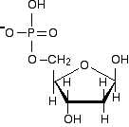
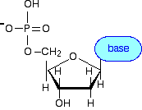
(Deoxy)ribose-phosphate
Sugar phosphorylated at C5 = sugar-phosphate backbone of DNA / RNA
(Deoxy)ribose-phosphate + base = Nucleotide

Slide 10
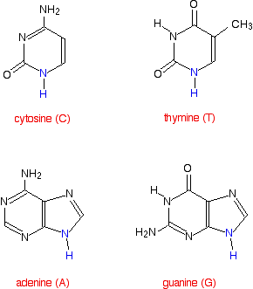
The bases:
Called bases because they are alkaline in chemical terms. But this is not of importance to their function in DNA. Just call them bases!
Pyrimidines
uracil (U)
= replaces T in RNA
Purines
(Nitrogen atoms in blue = attach to C1´ of ribose in a nucleotide)

Slide 11
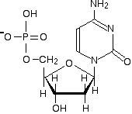
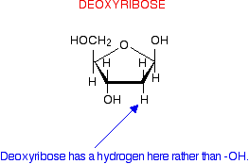
Phosphoric acid + sugar + base = nucleotide
(The basic repeating unit of nucleic acid)
-
-

Slide 12
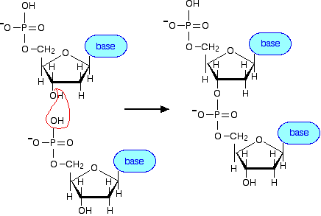
Joining nucleotides into a polynucleotide strand
Nucleophilic attack of 3´OH group onto 5´phosphate group of next nucleotide
=
Phosphodiester bond
formation
H₂0
IMPORTANT: Biological reaction can ONLY proceed in 5´to 3´direction!

Slide 13
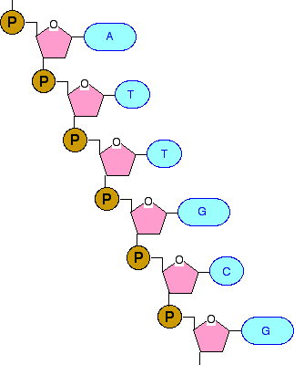
Simplified view of 1 strand….
…but DNA is double stranded…

Slide 14
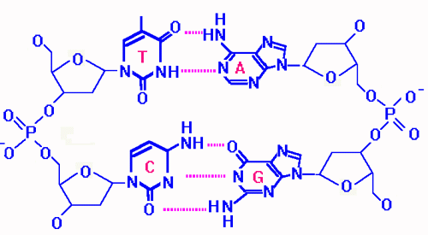
Base-pairing
Based on hydrogen bonds (weak attractions, rather than strong chemical bonds)
G always binds to C, A always binds to T
G:C = 3 hydrogen bonds / A:T = only 2
Always a purine and a pyrimidine in a pair
DNA with high GC content is more difficult to “melt” (separate the strands)

Slide 15
Structure of DNA
Notice that strands go opposite directions (5´- 3´) = antiparallel.
Basis of data storage in DNA = if you have one strand, you have all the information, and can copy it to double-stranded form.

Slide 16
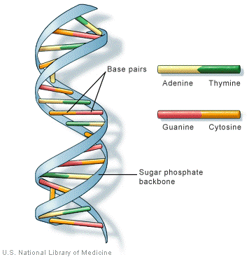
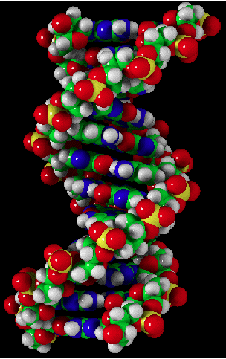
3D Structure of DNA = double helix
Major groove
Minor groove

Slide 17
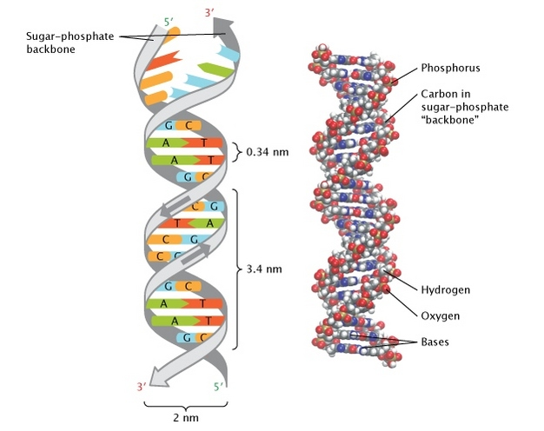
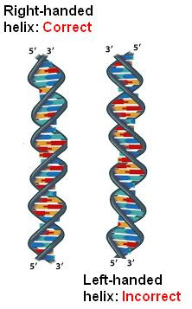
Some final details on DNA 3D structure:
It forms a right-handed helix…
of (fairly) regular dimensions
10-10.5 bases per turn
Laurence Moran

Slide 18
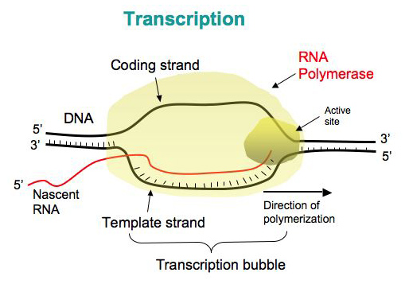
Transcription of RNA
By DNA-dependent RNA polymerase
Langara College

Slide 19
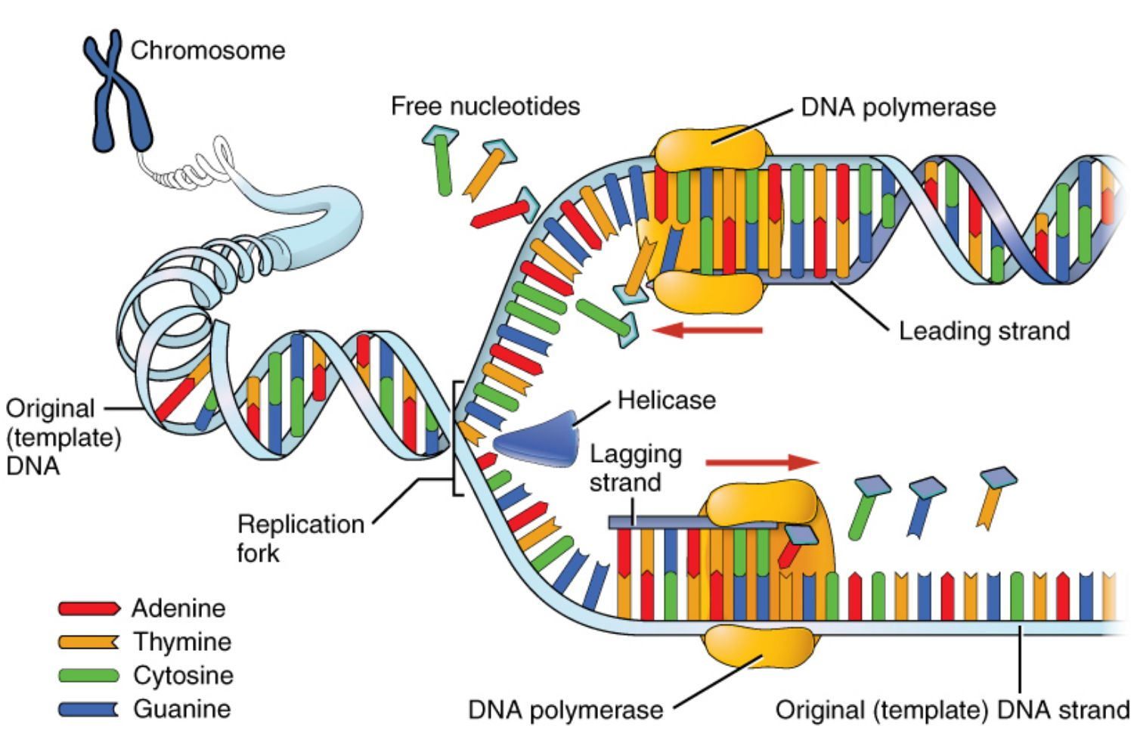
Replication of DNA
By DNA-dependent DNA polymerases
wikipedia

Slide 20
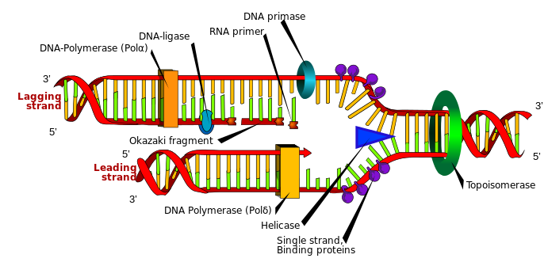
Replication of DNA (in some more detail)

Slide 21
Stability / reactivity of DNA and RNA
dsDNA
ssDNA
ssRNA
OH
U
OH
U
OH
OH
OH
Stability +++++ +++ +
Reactivity + + +++++

Slide 22
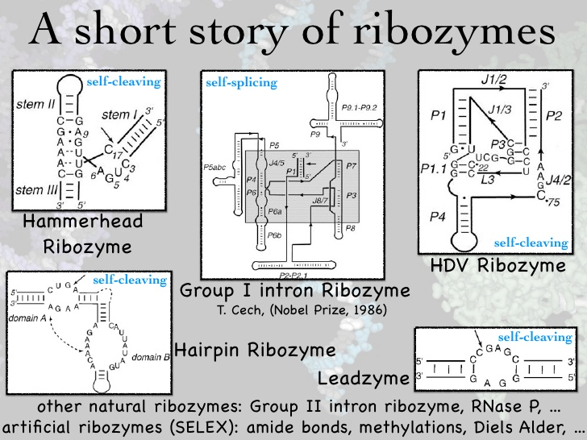
Reactive RNA: ribozymes (i.e. RNA enzymes)
slideshare

Slide 23
Build some model DNA!

Slide 24
Topics:
Tree of life
Building blocks of life
Structure (and differences) of DNA and RNA
DNA makes RNA makes protein
Genomes and genomic features
Genetics
Epigenetics

Slide 25
4. DNA makes RNA makes protein
“The central dogma of molecular biology”
(Attributed to Francis Crick, although not the words he used)
replication
DNA
transcription
RNA
translation
protein

Slide 26
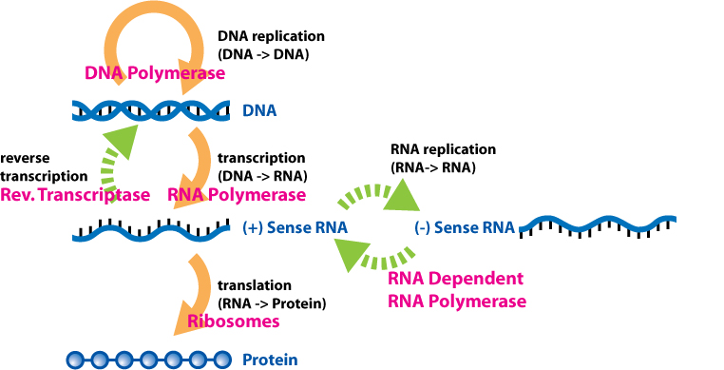
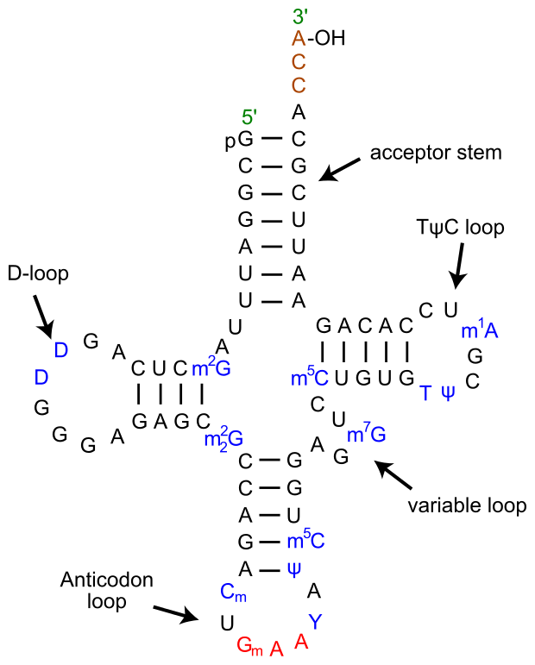
4. DNA makes RNA makes protein (cont.)
The central dogma in some more detail
tRNA
wikipedia

Slide 27
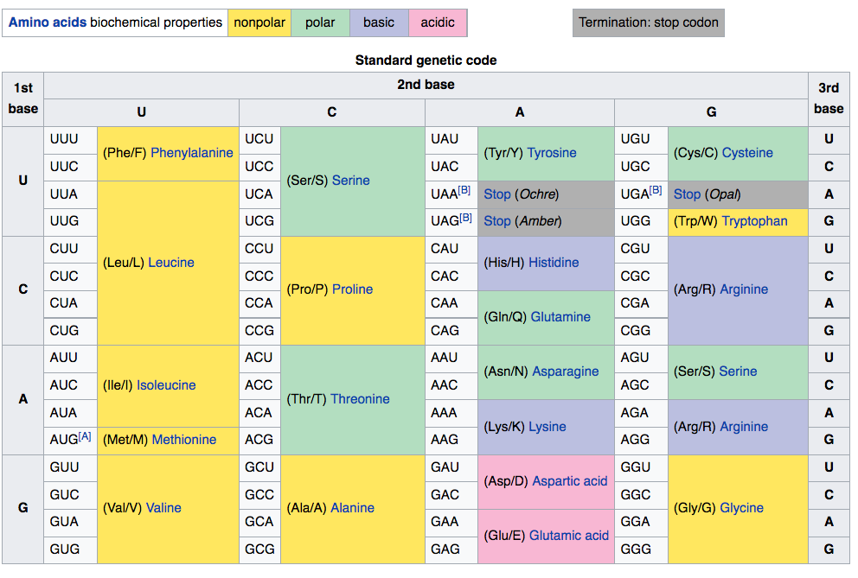
The genetic code
- Genes use a 3-letter word (called a codon) to direct protein synthesis
- There are 20 amino acids that make up all natural proteins
3-letter code with an alphabet of 4 letters (AGCT) = 4³ = 64 possible codons
In RNA, letters become AGCU
Start codon

Slide 28
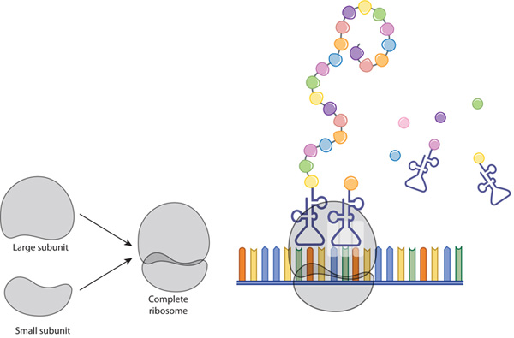
Translation
Occurs on the ribosome. All three major types of cell RNA involved.
N
C
Transfer rRNAs - tRNA
5´
3´
Messenger RNA - mRNA
Nature Education
Contains ribosomal RNA
- rRNA (28S, 18S and 5S)
mRNA is read 5´to 3´
Protein is synthesis N-terminus to C-terminus
In a typical cell, >90% of all RNA is rRNA!

Slide 29
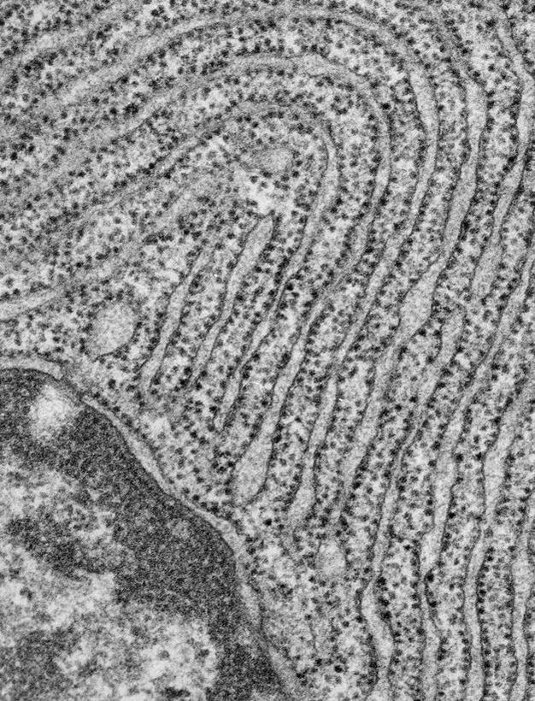
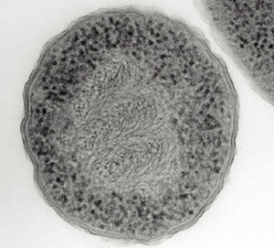
Ribosomes
The ribosome is a ribozyme!
Electron micrograph of prokaryotic cell showing DNA in center and ribosomes on periphery.
Electron micrograph of eukaryotic cell showing endoplasmic reticulum studded with ribosomes.
Nature education

Slide 30
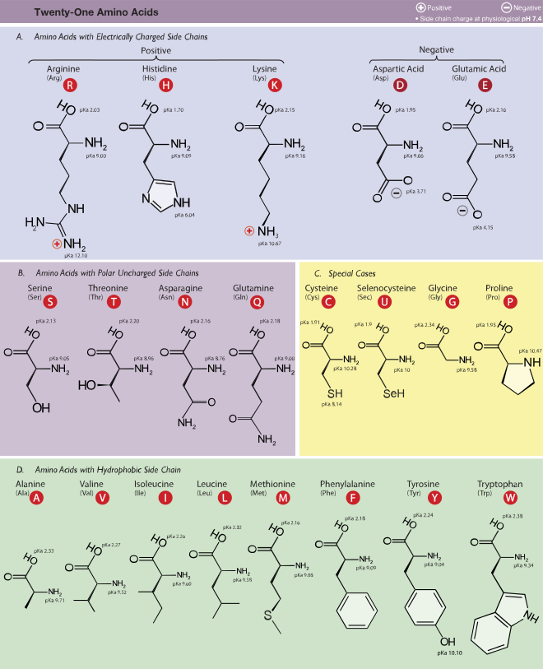
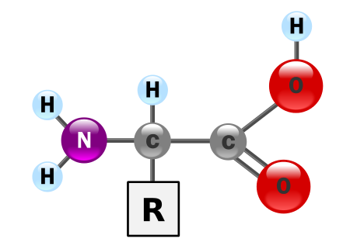
Amino acids and their properties
Chemical structure common to all amino acids
wikipedia

Slide 31
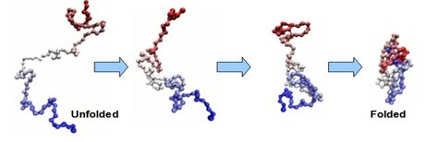
Protein folding
Factors driving / affecting protein folding:
- Hydrophobic interactions
- Ionic interactions (+ and – charges)
- Hydrogen bonds
- Metal ion binding
- Chaperone protein interactions
- Effects of salt and pH

Slide 32
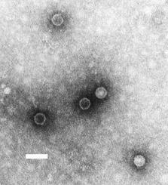
5. Genomes and genomic features
Not all genomes are of double-stranded DNA:
ssRNA viruses (e.g. Poliovirus)
dsRNA viruses (e.g. Rotavirus)
ssDNA (e.g. bacteriophage PhiX 174)
Poliovirus. Scale bar = 50 nM (credit: US EPA)
Viruses tend to have high mutation rates because:
RNA polymerases do not have proofreading (spell checking) activity
DNA is more stable in double-stranded form. Rearrangement and mutations more likely in ssDNA.

Slide 33
Genomes of dsDNA:
Ploidy (the number of sets / copies of chromosomes in a cell or organism):
Haploid = 1 copy of dsDNA genome
e.g. bacteria (typically circular genomes)*
e.g. yeast (16 linear chromosomes)
e.g. male bees, ants, wasps
Diploid = 2 copies of genome (one from mum, one from dad)
e.g. us (note that 3.2 Gb genome = haploid size)
e.g. yeast
Triploid = 3 copies
e.g. wheat
Tetraploid = 4 copies
e.g. potato, Salmon
1048576-ploidy has been measured in silk gland of silkworm!
* Commonly also contain extra circles of DNA called plasmids, that can be transferred between bacteria (also between different species). Common mechanism for the spread of antibiotic resistance.
Polyploidy
Notes:
Why does it exist – mention evolutionary advantage in plants (more invasive plants tend to be polyploid, most threatened species tend to be diploid). Could allow genetic “experimentation”.

Slide 34
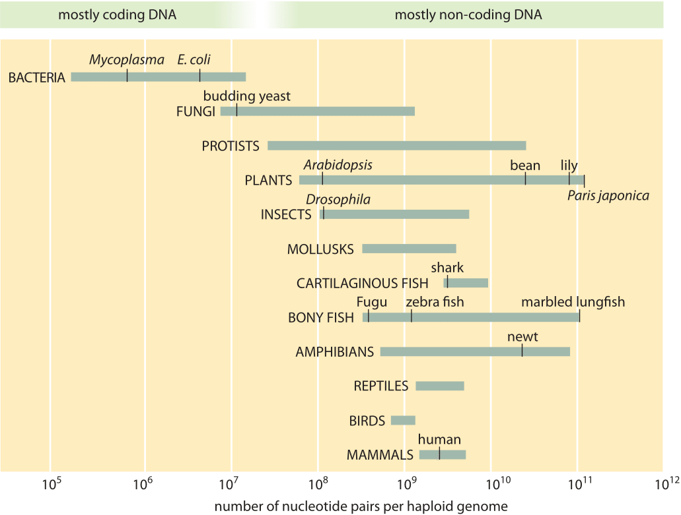
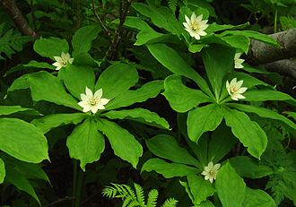
Genome Sizes
Smallest (independently surviving cell) genome: Mycoplasma genitalium
= 600 kb genome / 525 genes
(synthetic biology has created a minimalistic version with 531 kb / 473 genes)
Largest genome: Paris japonica
= 150 Gb genome
http://book.bionumbers.org/how-big-are-genomes/)

Slide 35
Genome Sizes
For organisms that have not had their genome sequenced / have poor assemblies / lots of repetitive DNA, genome size estimated using “C number” = amount of DNA (in pg) in a haploid genome (eg a sperm cell).
1 pg = 978 Mb (ca. 1 Gb)
Database of eukaryotic genome sizes:
http://www.genomesize.com/
NOTE:
Large Genome ≠ many genes!
(generally means lots of repetitive and non-coding DNA)

Slide 36
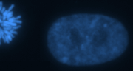

Genomic structure and features
Cells stained with DNA-dye DAPI
Nucleus undergoing mitosis
(cell division)
wikipedia
Interphase nucleus
(how nuclei look most of the time)
Protects ends
Euchromatin
(open, expressed)
Essential for cell division
Heterochromatin
(dense, repressed)
171 bp repeat in humans
DNA in cells = protein bound = Chromatin

Slide 37

Genomic structure and features
Gene A
Gene B
Gene C
repeats
Boundary / insulator
Enhancer
Gene D

Slide 38

Genes in more detail
translation
PROTEIN

Slide 39

Splicing in more detail

Slide 40

Splicing – one example
Note: Only ca. 1.5% of the human genome codes for protein!

Slide 41

Splicing: one gene = many proteins
Average human gene = 8.8 exons
Average exon size ≈160 bp
To add to the complexity of the proteome: Most proteins can be post-translationally modified (acetylated, phosphorylated etc.).

Slide 42

Promoters
(of protein-coding genes = Pol II transcribed)*
ca. 1000 bp
ca. 200 bp
Promoter
*
Pol I = transcribes the two large rRNAs (18S and 28S)
Pol III = transcribes small rRNA (5S), tRNAs, and other small RNAs.
TATA = sequence typically found in ca. 50% promoters
(binds TBP; TATA binding protein)
INR = initiator element, where Polymerase binds
DPE = downstream promoter element

Slide 43
Repeats
“Microsatellites”. Very short, < 10 bp,
(particularly dinucleotide, trinucleotide and telomeric (6-8 bp)
2. “Minisatellites”. 10-50 bp (eg centromeric repeats)
3. Transposons and retrotransposons.
“Copy and paste” genetic elements
Retro = Transcribed to RNA -> copied back into DNA at new location
May encode enzymes to do so (many copies are dysfunctional remnants)
e.g. SINE and LINE elements
- 42% of the human genome is derived from retrotransposons!
Also called SSRs, STRs and VNTRs. Used in forensics.

Slide 44
e.g. problem of repeats in genome assembly
repeat
genome
Sequence reads
assembly

Slide 45
6. Genetics: What is a gene?
You can also have non-coding genes (RNAs that do not contain a reading frame encoding protein) – eg. rRNA, antisense transcripts, Xist
miRNAs sequences are often transcribed in UTR sequences
Poly-cistronic RNAs (common in bacteria) = multiple gene sequences in one mRNA.

Slide 46

What is a locus?
Locus = place in the genome where a particular gene resides.
If the gene responsible for a particular trait (eg a disease) has not been identified, we may still know the locus resides on a particular area of a chromosome.
A locus can contain more than one gene, and there can be more than one locus for a kind of gene in the genome. e.g.
the rDNA loci = in humans, 5 chromosomes carry the rDNA – each contains many copies of the rRNA gene (about 200 copies in total).
HLA locus (important in immunology) = on chromosome 6, >200 genes
The locus for Down´s syndrome = entire chromsome 21

Slide 47

What is an allele?
= A variant of any one gene.
Eg a gene where one variant encodes blue eyes, the second variant encodes brown eyes, has two alleles.
The variants can be single nucleotide polymorphisms (SNPs), larger differences in sequence, copy number variants (CNVs), splice variants, insertions / deletions (indels).
Often discussed in terms of heredity

Slide 48

Zygosity
Both alleles the same
Two different alleles
Only one allele possible

Slide 49

Dominant and recessive alleles
Since we have 2 copies of our genes (diploid):
If both alleles at a given locus contribute to phenotype = co-dominance
If only one allele is displayed in phenotype = dominant allele
For a recessive allele to display phenotype, both copies must be the recessive allele.
Genome Research Limited

Slide 50




Mutations, variants and polymorphisms
Molecular genetics
Population genetics
AGCTTGCATTGAATCG
Process by which variation arises = mutation
AGCTTGCAATGAATCG
AGCTTGCAGTGAATCG
Black coat variant (arose by mutation several generations ago) is a polymorphism inherited by a minority of individuals. This flock also contains two mutants that have arisen spontaneously.Only one looks damaging.
Benign, no disease
= variant
Disease-causing
= mutation

Slide 51

Silent, missense and nonsense mutations
libretexts

Slide 52

Somatic vs Germline mutations, and mosaicism
Germline = testes, ovaries (sperm and eggs)
Soma = all other tissues
Spontaneous germline mutation
Mosaic individual.
If mutation present in germ cells, can be inherited by next generation
Man develops cancer
Spontaneous somatic mutation

Slide 53

Difference between somatic cell division and DNA replication (mitosis) and germ-line (meiosis)

Slide 54

Difference between somatic cell division and DNA replication (mitosis) and germ-line (meiosis)
apbio

Slide 55


Every cell in your body contains the same DNA
(almost)
Exceptions:
Red blood cells (lose their nuclei)
B-cells (undergo genomic rearrangement to produce different antibodies)
Sperm / egg and precursors = undergo meiotic recombination
Cancer cells
Somatic mutations that accumulate as you develop and age.
Which genes are turned on / off at a given time or in a tissue determine cell identity.

Slide 56

7. Epigenetics: Heritable traits not encoded in the DNA sequence.
-Me
wikipedia
Mediated by:
-DNA methylation
-Histone variants
-Histone covalent modification
-Non-coding RNAs (miRNAs, long non-coding RNAs)
-Nucleosome remodelling (positioning) and chromatin compaction
-Nuclear position

Slide 57

DNA packaging (DNA + packaging proteins = chromatin)
-Each cell in your body contains about 2m DNA (in 46 pieces i.e. chromosomes)
- All that has to be packed into a nucleus that of approx 5 µm diameter – which is why you need chromatin!
All the DNA in your body (10¹³-10¹⁴ cells), if aligned end to end could stretch 5-50 times from the earth to the sun…

Slide 58

Histones + nucleosomes
2 of each core histone + 150 bp DNA = nucleosome!
Histone proteins:
Small (ca. 100-140 aa)
Highly conserved
Package DNA
4 core histones:
H2A
H2B
H3
H4
Luger et al, 1997
N-terminal TAILS

Slide 59

Histone tails are targets for modifications
Post-translational modifications
-acetylation
-methylation
-phosphorylation
-Ubiquitylation
-SUMOylation
-Citrullination / deimination
-Proline isomerisation
-ADP-ribosylation
-Palmitoylation
-GlcNac
These modifications control how tightly the chromatin is packed (eg condenses to heterochromatin), attract or repulse transcription factors, signal damage etc.

Slide 60

DNA methylation
Occurs most in CG (also known as CpG) context in mammals.
Also common in CHH and CHG in plants (H= A, C or T)
Adenine and cytosine methylation common in selected sequence motifs in bacteria as an antiviral defense. Express an enzyme that cuts a DNA sequence (restriction enzyme): non-methylated viral DNA gets cut, methylated bacterial DNA protected.
(aka 5mC)
Also get adenine methylation

Slide 61

DNA methylation in vertebrates
5mC promotes transcriptional repression (can block TF binding directly, and can recruit proteins that cause chromatin condensation)
Clusters of non-methylated C found at ca. 65 % of vertebrate promoters
5mC mutates more frequently to T, therefore gradual conversion of CG to TG in genome, except in promoters that are actively demethylated = gives rise to “CpG islands”.

Slide 62
Topics:
Tree of life
Building blocks of life
Structure (and differences) of DNA and RNA
DNA makes RNA makes protein
Genomes and genomic features
Genetics
Epigenetics

Slide 63


Slide 64

Thanks for your attention
www.sequencing.uio.no
post@sequencing.uio.no
gregorg@medisin.uio.no

